Slide 1
IRCC11-06.1C
EAHC Report
Japan
EAHC Chair

Slide 2
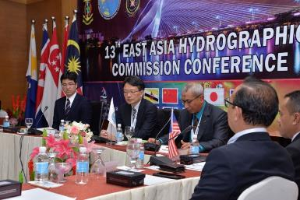
Outline of EAHC
Membership
Member States - Brunei, China, DPR Korea, Indonesia, Japan, Malaysia, Philippines, Rep of Korea, Singapore, Thailand, Vietnam (provisional)
Observers: Cambodia (non-IHO MS), Timor Leste (non-IHO MS), US, UK
Chair - Dr. Yukihiro KATO (Japan) (September 2018- , until the next EAHC Conference in 2021)
Vice Chair - RADM HARJO SUSMORO (Indonesia) (September 2018- , until the next EAHC Conference in 2021)
Structure
13th EAHC Conference,
September 18th -20th , 2018
EAHC Steering Committee
EA Training, Research and Development Center
（TRDC）
Regional ENC Coordinating Center (RECC)
Charting and Hydrography Committee
(CHC)
Marine Spatial Data Infrastructure Working Group (MSDIWG)

Slide 3
Meetings since IRCC10 (June 2018)
13th EAHC Conference, Putrajaya Malaysia, 18-20 September 2018.
7th EAHC Charting and Hydrography Committee (CHC) Meeting, Chiangmai, Thailand, 28-29 November 2018.
1st EAHC MSDIWG Meeting, Chiangmai, Thailand, 29-30 November 2018
9th EAHC Training and Research Development Committee (TRDC) Board of Director (BoD) Meeting , Bali, Indonesia, 18-19 February 2019.
6th EAHC Steering Committee (SC) Meeting, Bali, Indonesia, 20-22 February 2019.
Group Photo
13th EAHC Conference, Putrajaya Malaysia, 18-20 September 2018.
IHO SG, UK and US also attended.

Slide 4
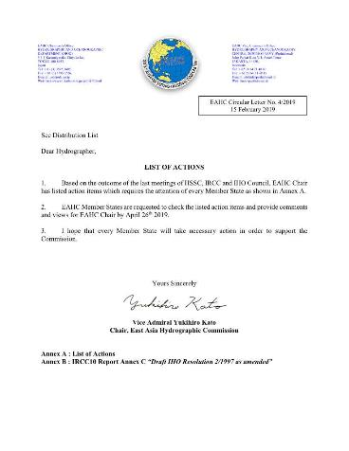
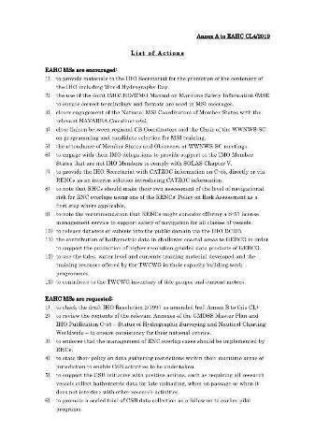
Status of LIST OF RECOMMENDATIONS TO RHCs “IRCC10 Report – Annex F”
EAHC Chair sent a Circular letter to request EAHC MSs to deal with the list of recommendations “IRCC10 Report – Annex F”

Slide 5
Status of LIST OF RECOMMENDATIONS TO RHCs “IRCC10 Report – Annex F”
Particularly, status of requests in EAHC are as follows.
Items of requests | Status
to check the draft IHO Resolution 2/1997 as amended (ref: Annex B to this CL) | EAHC has no objections on the draft IHO Resolution 2/1997.
to review the contents of the relevant Annexes of the GMDSS Master Plan and IHO Publication C-55 – Status of Hydrographic Surveying and Nautical Charting Worldwide – to ensure consistency for their national entries. | Ongoing
to endorse that the management of ENC overlap cases should be implemented by RHCs. | EAHC has no objections on this item.
to state their policy on data gathering restrictions within their maritime areas of jurisdiction to enable CSB activities to be undertaken. | Ongoing
to support the CSB initiative with positive actions, such as requiring all research vessels collect bathymetric data for late uploading, when on passage or when it does not interfere with other research activities. | Ongoing
to promote a scaled trial of CSB data collection as a follow on to earlier pilot programs. | Ongoing

Slide 6
Activities -Capacity building 2018-2019 -
- Basic Cartography and Hydrography Courses
- TV to Cambodia
Basic Cartography and Hydrography Courses

Slide 7
Activities EAHC 50th Anniversary in 2021 –”Golden Jubilee”-
EAHC was established in 1971, and 2021 will be the 50th anniversary of EAHC.
EAHC has established EAHC 50th celebration Task Group (EAHC 50th TG) led by Japan for the preparation and consideration of EAHC 50th events.
The Events are being considered by EAHC Member States by correspondence and the outline will be reported at the next EAHC Steering Committee (SC) in February 2020.

Slide 8
Activities - EAHC Strategic Plan -
In 2017, EAHC established “Strategic Team Advance Roadmap (STAR) Task Group” led by Japan to develop a Strategic Plan of EAHC including associated key objectives for EAHC to meet future needs.
EAHC has considered the EAHC Strategic plan based on the discussion and progress of the IHO SPRWG.

Slide 9
Action requested to IRCC
The IRCC is invited to note this report.

